Slide 1

Watson Assistant Labs
Lab 6: Integrating External Data using IBM Cloud Functions

Slide 2

Objective
Extend your chatbot to provide a new function
Allow the user to request information about a mobile phone model
Follow a demo script for your completed chatbot!
Uses
Watson Assistant contextual entities
Importing of entities
IBM Cloud Function to query Wikipedia

Slide 3
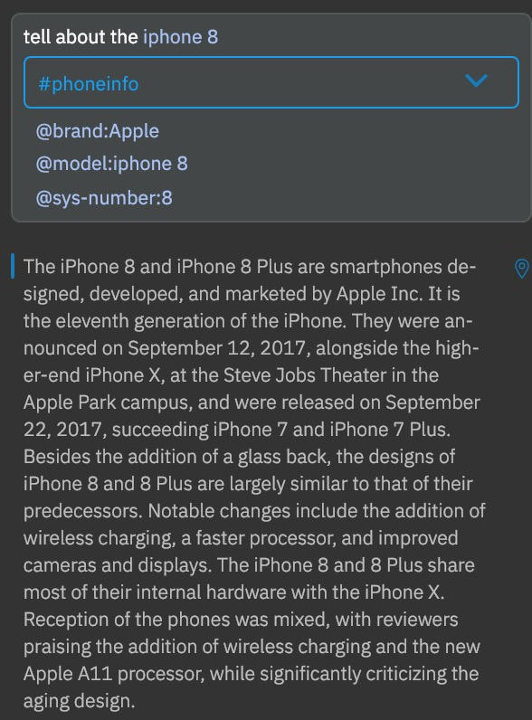
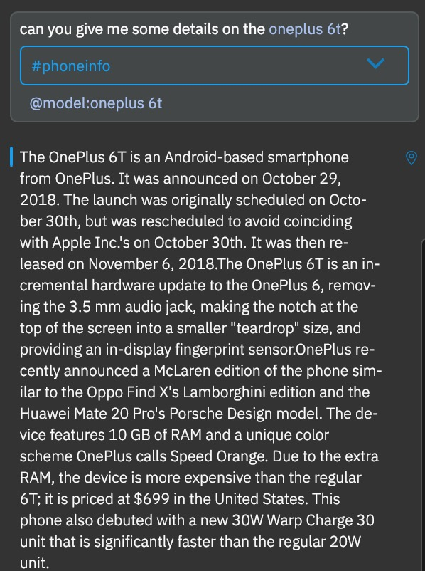
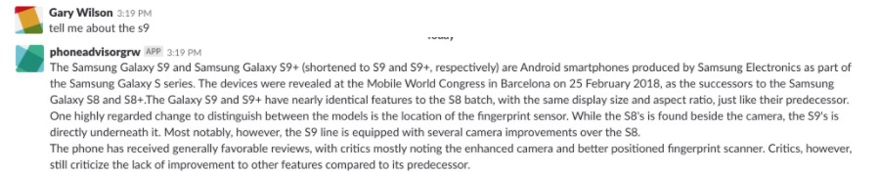
Objective

Slide 4
Agenda
Create new #phoneinfo intent
Use Watson Assistant contextual entities
Import entity values in Watson Assistant
Build searchWikipedia IBM Cloud Function
Create Phone Information dialog
Follow a final demo script!

Slide 5
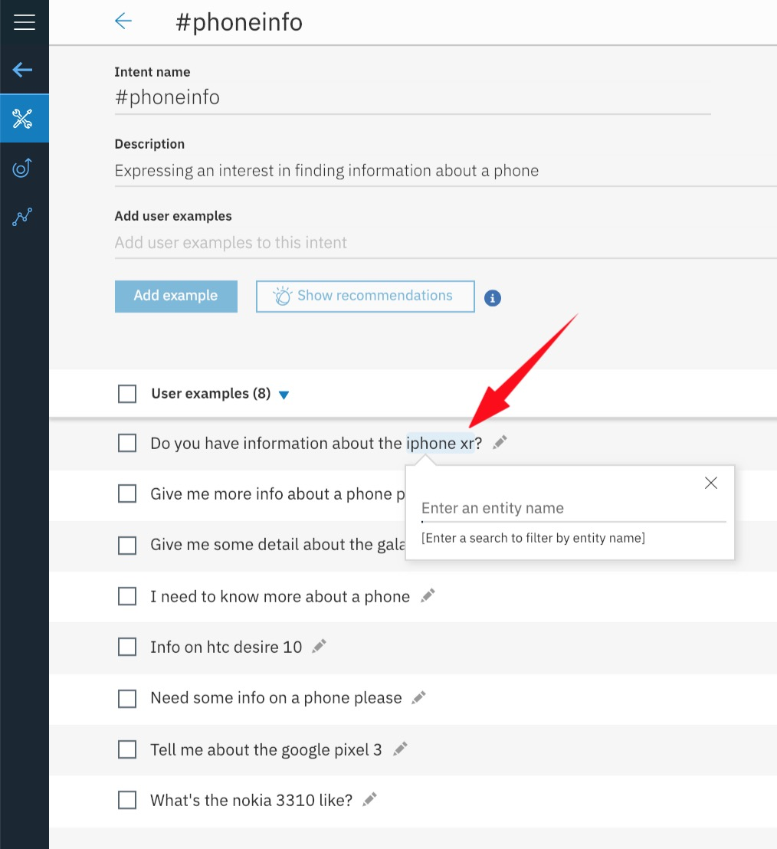
Watson Assistant: Contextual Entities
Annotate occurrences of the entity via user examples in your intent
Teaches Watson Assistant about the context in which an entity is typically used
Watson Assistant uses contextual entities to automatically pick up entity values

Slide 6
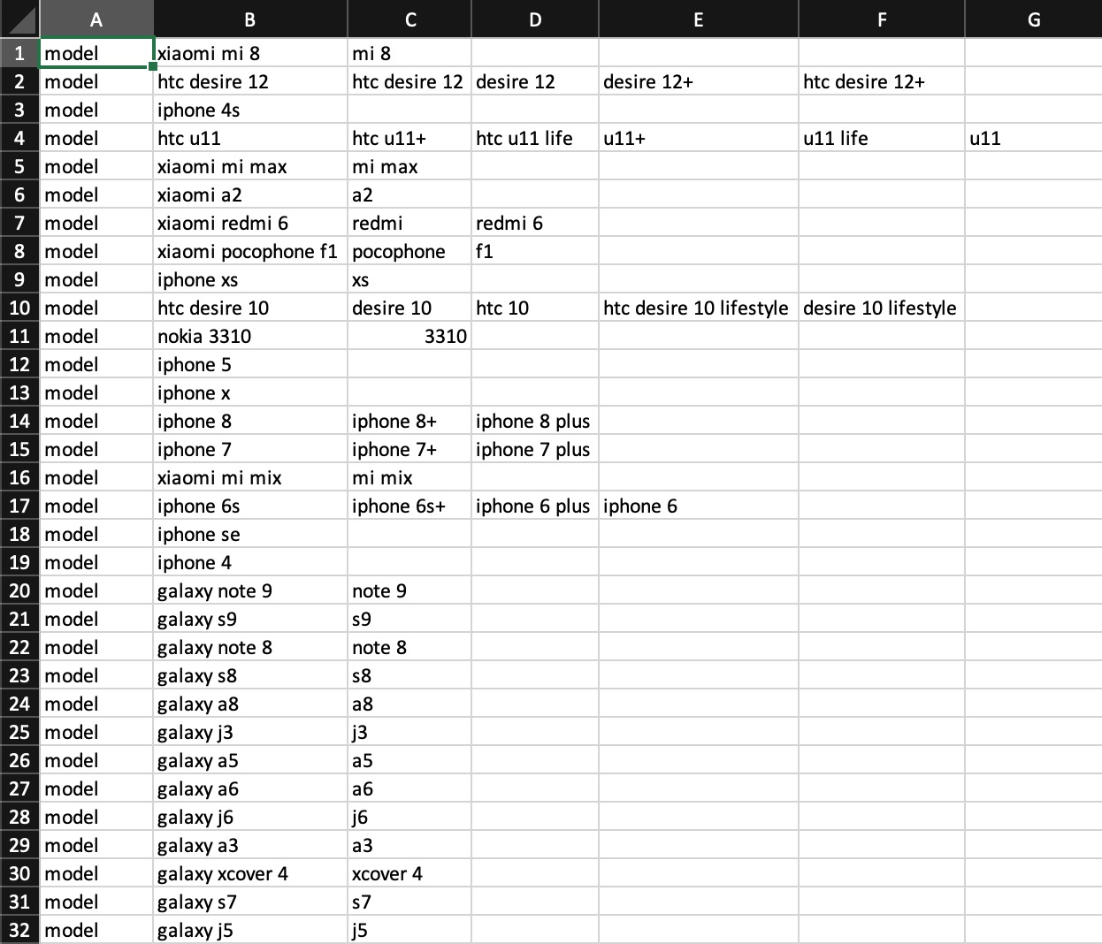
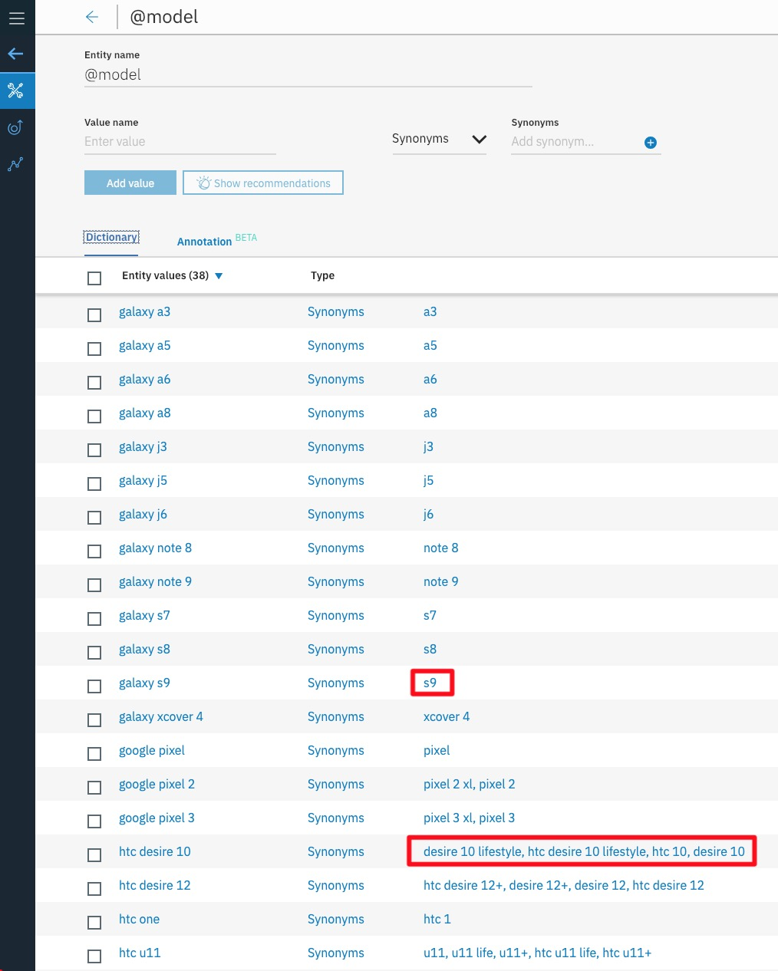
Watson Assistant: Import Entities
Helpful when:
creating large numbers of entities
building entities outside of the Watson tooling
import entities from a previously downloaded skill

Slide 7
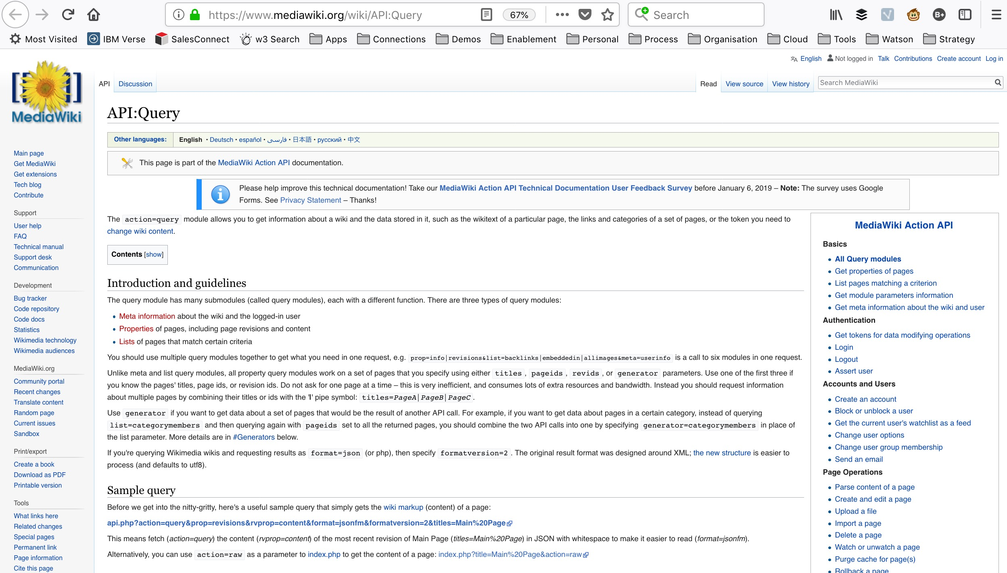
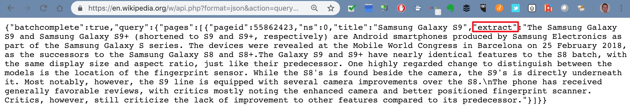
Use Wikipedia API to build
IBM Cloud Function

Slide 8
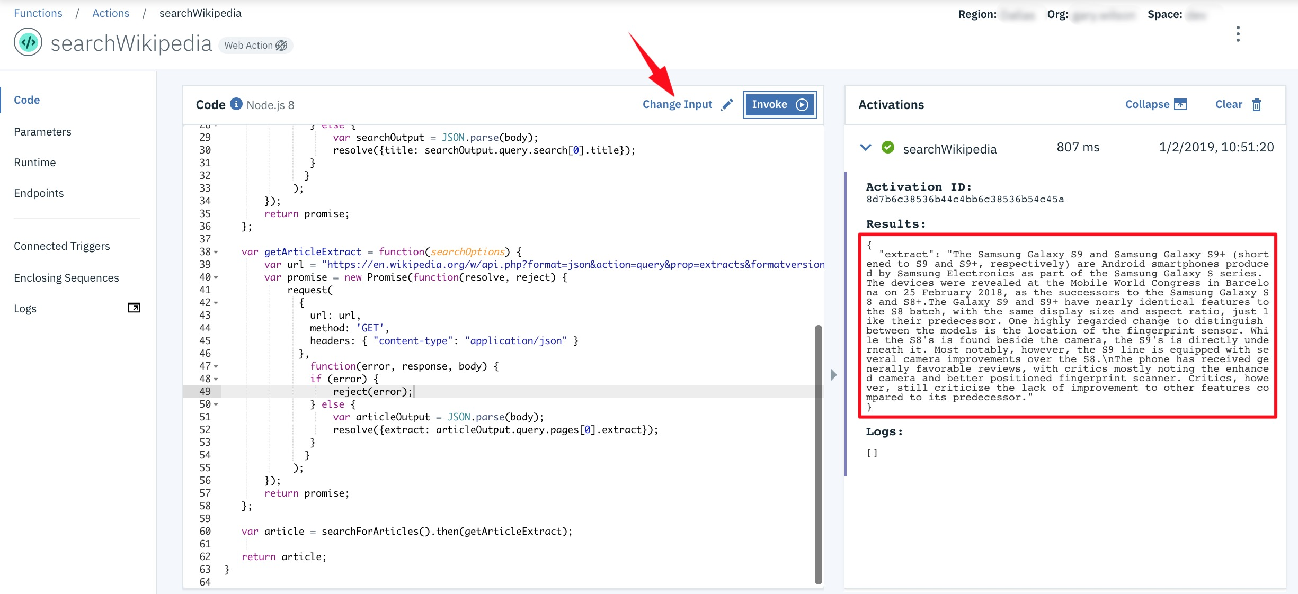
Use Wikipedia API to build
IBM Cloud Function

Slide 9
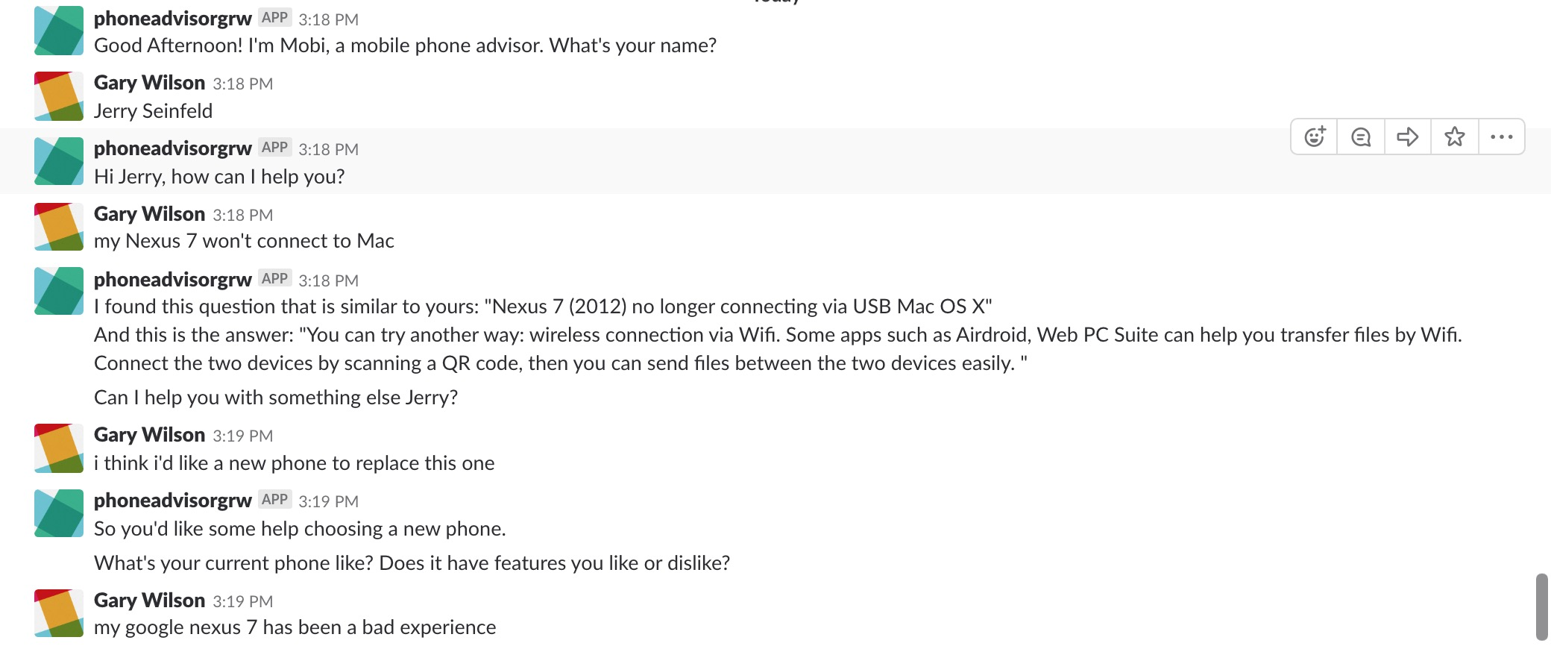
Demo Your Chatbot!

Slide 10
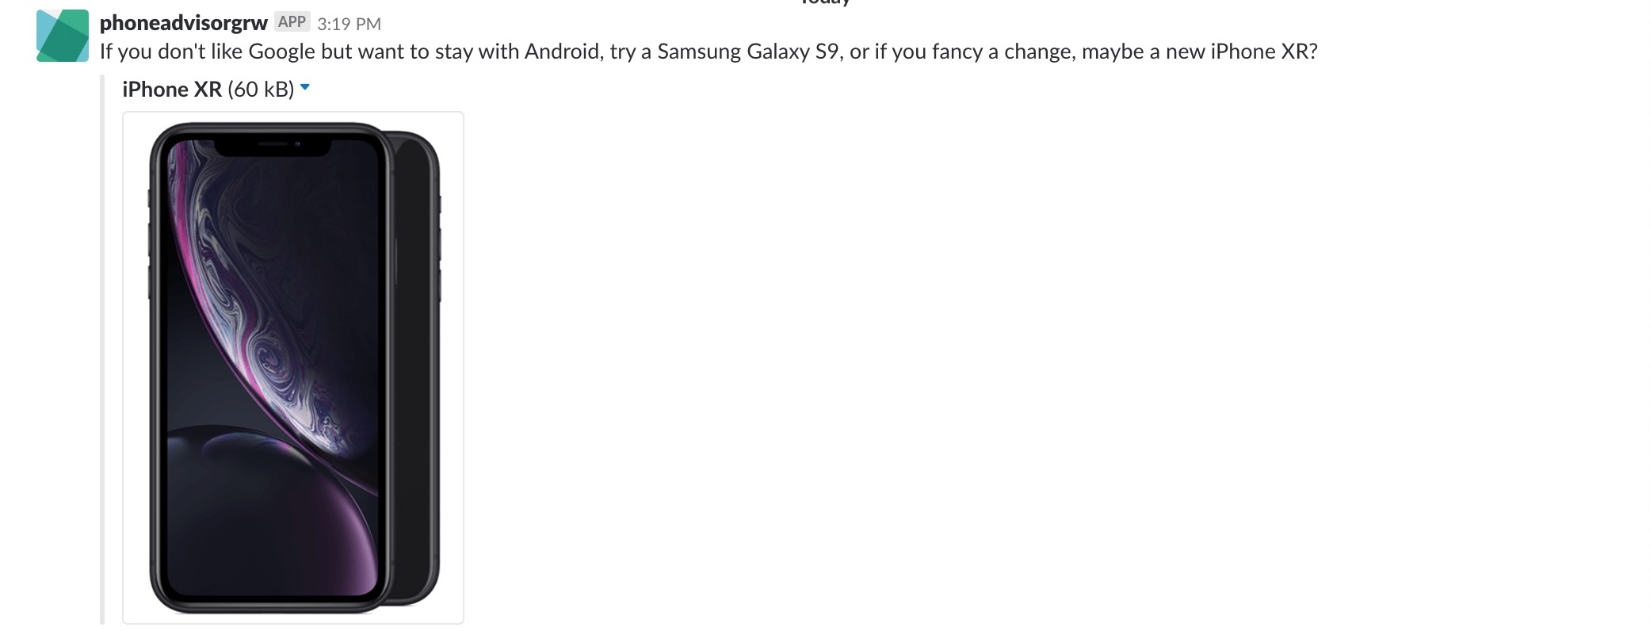
Demo Your Chatbot!

Slide 11
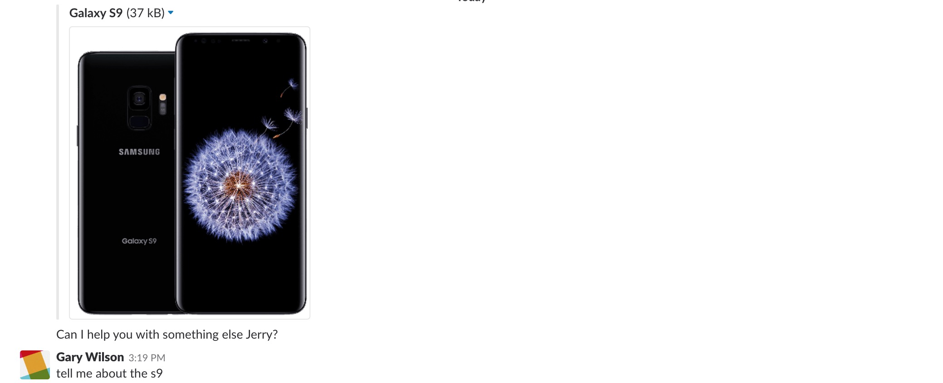
Demo Your Chatbot!

Slide 12
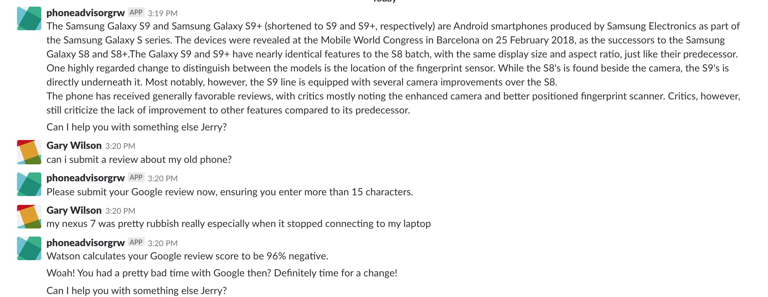
Demo Your Chatbot!

Slide 13
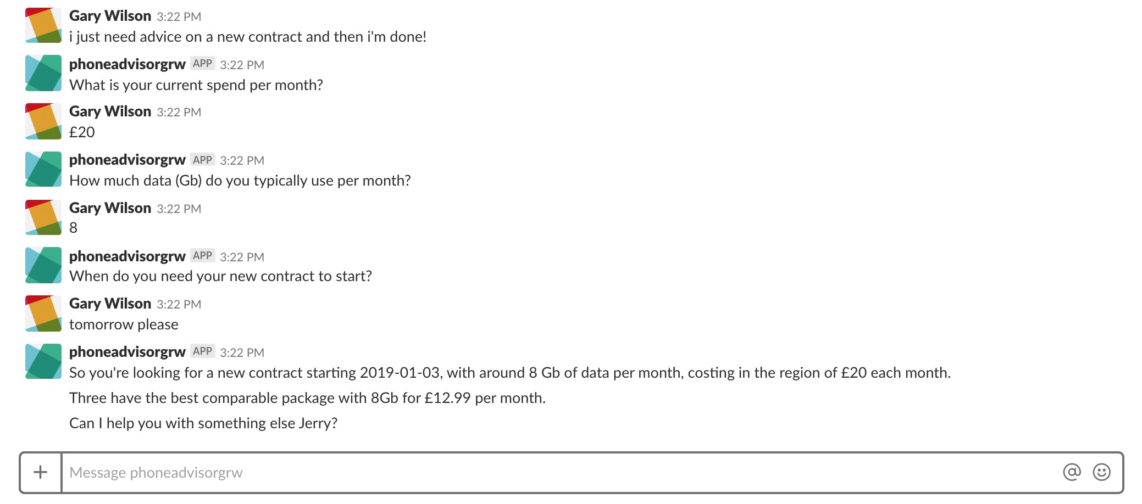
Demo Your Chatbot!

Slide 14
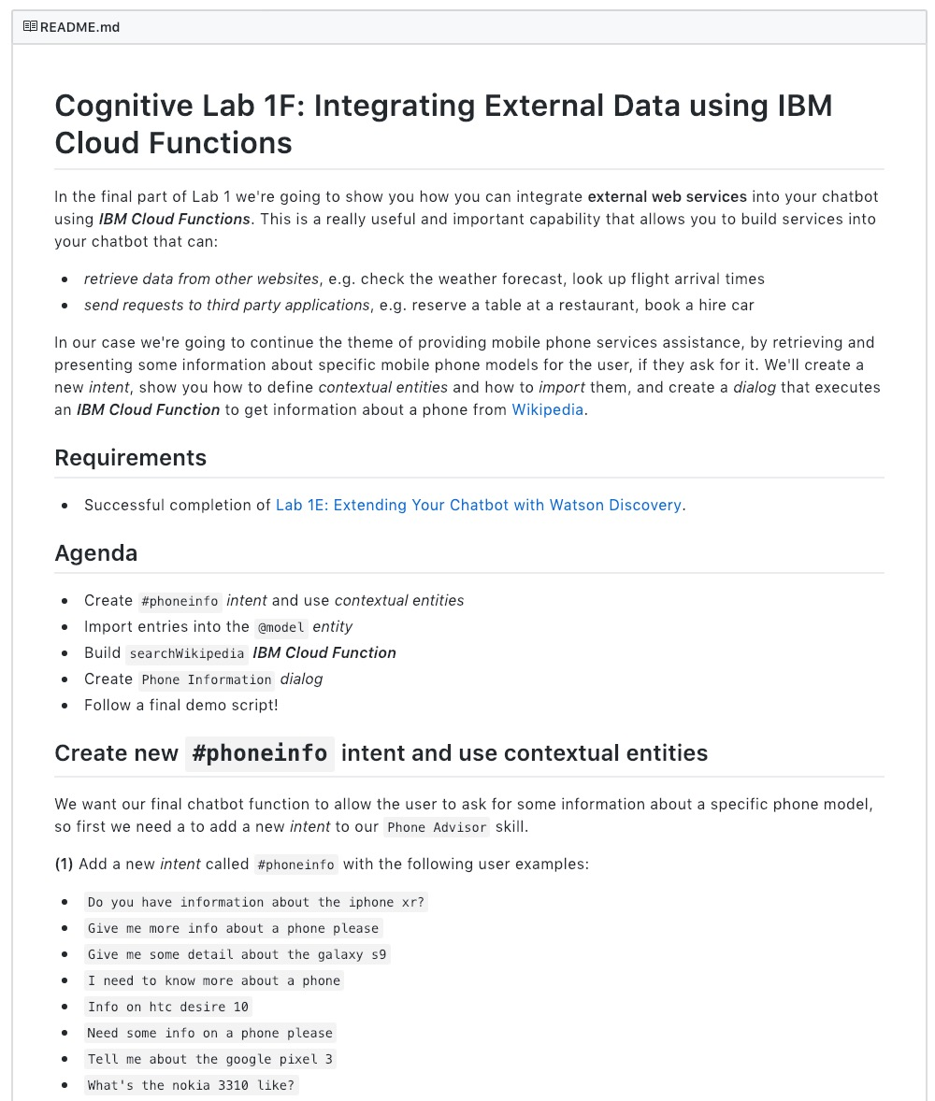
Lab Format
Step-by-step instructions
GitHub README.md for each lab
Work at your own pace
https://github.com/garyrwilson/Watson-Assistant-Labs/6-External

Slide 15
Cognitive Labs
Lab 6: Integrating External Data using IBM Cloud Functions

